Slide 1

Rockbuster Stealth
Data Analysis

Slide 2
Project Overview
Rockbuster Stealth LLC is a movie rental Company that used to have stores around the world.
The Opportunity: Rockbuster Stealth is facing robust competition from streaming services such as Netflix and Amazon Prime, therefore, the Rockbuster Stealth Management team is planning to use its existing movie licenses to launch an online video rental service in order to stay competitive.

Slide 3
Key Questions
Which movies contributed the most/least to revenue gain?
What was the average rental duration for all videos?
Which countries are Rockbuster customers based in?
Where are customers with a high lifetime value based?
Do sales figures vary between geographic regions?

Slide 4
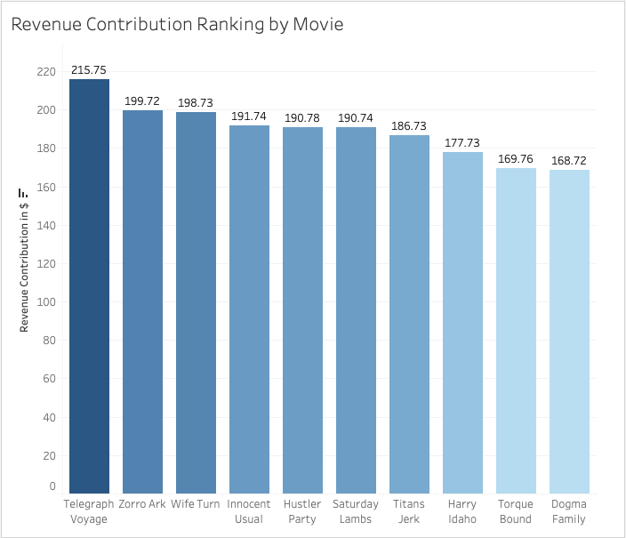
Which movies contributed most to revenue gain?
 | Title | Revenue Contribution
1 | Telegraph Voyage | $215.75
2 | Zorro Ark | $199.72
3 | Wife Turn | $198.73
4 | Innocent Usual | $191.74
5 | Hustler Party | $190.78
6 | Saturday Lambs | $190.74
7 | Titans Jerk | $186.73
8 | Harry Idaho | $177.73
9 | Torque Bound | $169.76
10 | Dogma Family | $168.72
Tableau Link

Slide 5
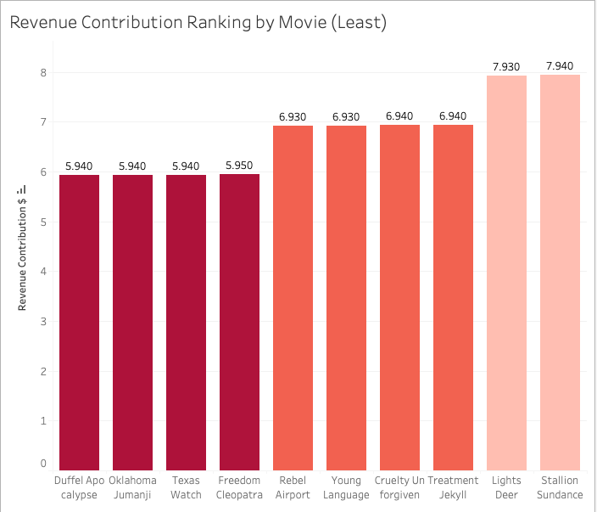
Which movies contributed the least to revenue gain?
 | Title | Revenue Contribution
1 | Texas Watch | $5.94
2 | Oklahoma Jumanji | $5.94
3 | Duffel Apocalypse | $5.94
4 | Freedom Cleopatra | $5.95
5 | Young Language | $6.93
6 | Rebel Airport | $6.93
7 | Cruelty Unforgiven | $6.94
8 | Treatment Jekyll | $6.94
9 | Lights Deer | $7.93
10 | Stallion Sundance | $7.94
Tableau Link

Slide 6
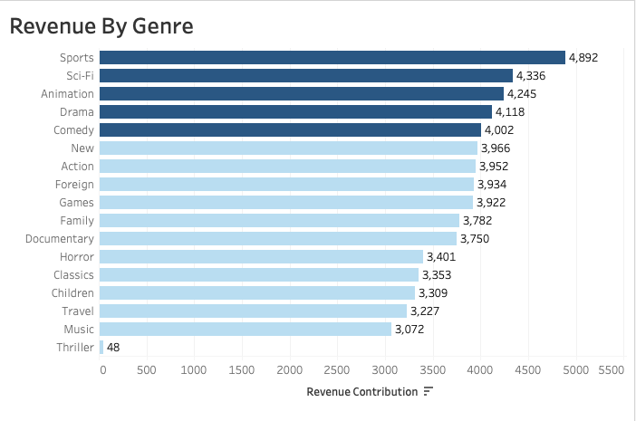
Most Profitable Movie Genres
TOP 5 MOVIE GENRES
Sports
Sci-Fi
Animation
Drama
Comedy
Tableau Link

Slide 7
What was the average rental duration for all videos?
The average rental duration for all videos is 4.9.
Average Rental Duration by Genre
 | Thriller | 6.0
 | Travel | 5.4
 | Music | 5.2
 | Family | 5.2
 | Foreign | 5.1
 | Drama | 5.1
 | Classics | 5.1
 | Games | 5.1
 | Children | 5.0
 | Action | 5.0
Average Rental Duration by Rental Price
 |  | $2.99 | 5.1
 |  | $4.99 | 5.0
 |  | $0.99 | 4.9

Slide 8
Film Rental Data
RENTAL DURATION
Minimum: 3 Days
Maximum: 7 Days
Average: 4.98 Days
FILM LENGTH
Minimum: 46 Minutes
Maximum: 185 Minutes
Average: 115 Minutes
RENTAL RATE
Minimum: $0.99
Maximum: $4.99
Average: $2.98
REPLACEMENT COST
Minimum: $9.99
Maximum: $29.99
Average: $19.98

Slide 9
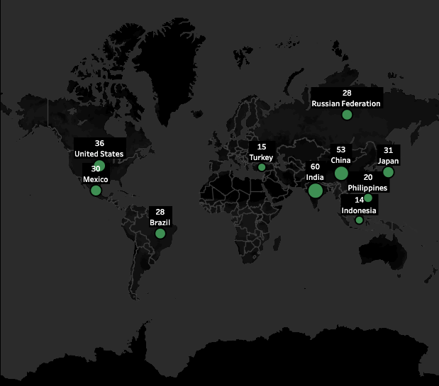
Top 10 Countries With The Most Customers
Top 3 Countries
India
China
United States
Tableau Link

Slide 10
Where are customers with a high lifetime based?
Top 20 Customers
First Name | Last Name | City | Country | Revenue
Eleanor | Hunt | Saint-Denis | Runion | $211.55
Karl | Seal | Cape Coral | United States | $208.58
Marion | Snyder | Santa Brbara dOeste | Brazil | $194.61
Rhonda | Kennedy | Apeldoorn | Netherlands | $191.62
Clara | Shaw | Molodetno | Belarus | $189.60
Tommy | Collazo | Qomsheh | Iran | $183.63
Ana | Bradley | Memphis | United States | $167.67
Curtis | Irby | Richmond Hill | Canada | $167.62
Marcia | Dean | Tanza | Philippines | $166.61
Mike | Way | Valparai | India | $162.67
Arnold | Havens | Santa Rosa | Philippines | $161.68
Wesley | Bull | Ourense (Orense) | Spain | $158.65
Gordon | Allard | Hodeida | Yemen | $157.69
Louis | Leone | Tanauan | Philippines | $156.66
Lena | Jensen | Halisahar | India | $154.70
Tim | Cary | Bijapur | India | $154.66
Warren | Sherrod | Usolje-Sibirskoje | Russian Federation | $152.69
Steve | Mackenzie | Probolinggo | Indonesia | $152.68
Brittany | Riley | Sumy | Ukraine | $151.73
Guy | Brownlee | Zhoushan | China | $151.69
Out of the Top 20 Customers, six of them are in the Philippines and India.
Those six customers represent 28% of the Revenue of the Top 20 customers.

Slide 11
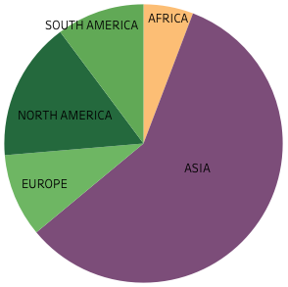
Do sales figures vary between Geographic Regions?
Revenue by Geographic Region
Geographic Region | Revenue
ASIA | $24,069.41
NORTH AMERICA | $6,679.09
SOUTH AMERICA | $4,217.99
EUROPE | $4,007.59
AFRICA | $2,384.38
6%
10%
16%
58%
10%
Tableau Link

Slide 12
Recommendations
Continue investing in Asia region with Marketing and Promotional Support
Emphasize Sports films in Asia region to maximize the region’s revenue on that genre
Consolidate/eliminate films that produce minimal revenue
Create unique film bundle packages that highlight Top-Selling genres at Discounted Rates
Reallocate some investments into regions that are low revenue producers, i.e. Africa
Reward High Value Customers:
Early access to New Releases
Rewards Program: Discount or Free Rental for every 5 movies rented

Slide 13
Thank You!
Analysis and Presentation by: Samuel Callender
Please direct questions to email: samueldcallender@gmail.com
Tableau Links
Slide 4
Slide 5
Slide 6
Slide 9
Slide 11

